Slide 1
A Survey for open domain dialog system
Lao Yadi

Slide 2
Outline
Introduction
Background
Encoder – Decoder Model
4. Conclusion
3.1 Model Modification
3.2 Extra Feature Injection
3.3 Latent Variable Representation
3.4 Prototype-then-edit model (*)

Slide 3
Introduction
Task-Oriented
Open Domain
Focus
Goal: Help users achieve a certain task
Combination of rule and statistical components
Goal: Sustain dialogue
Focus on natural response
Query retrieval or Generation model (variants of seq2seq )

Slide 4
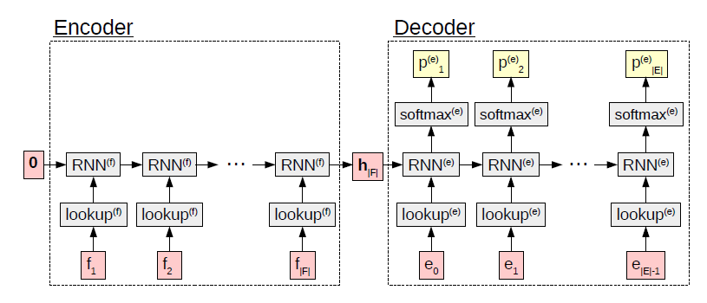
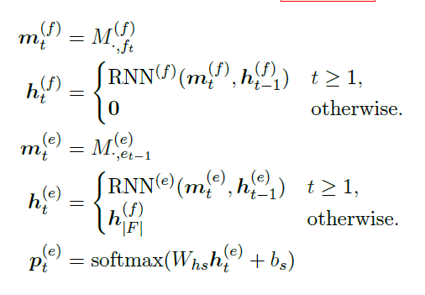
Background
Encoder-Decoder model (flexible and scalable)

Slide 5
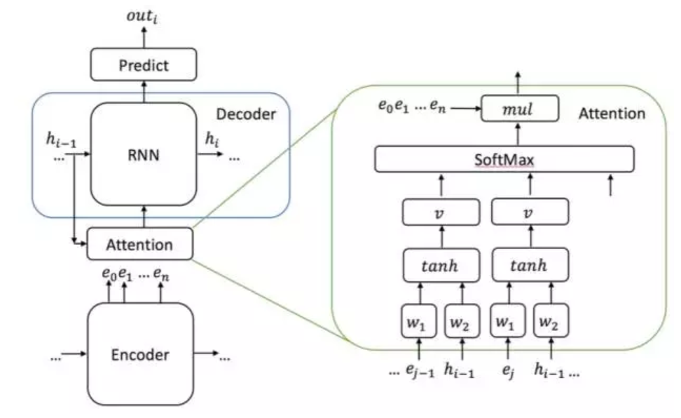
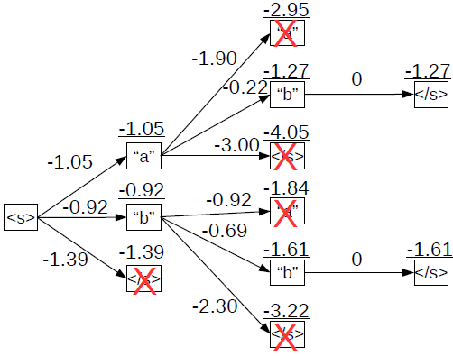

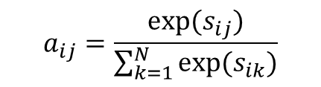
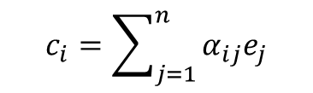
Background
Attention mechanism
Beam Search
$$c_{i}=\sum_{j=1}^{n}{α_{ij}e_{j}}$$
$$a_{ij}=\frac{exp⁡(s_{ij})}{\sum_{k=1}^{N}{exp⁡(s_{ik})}}$$
$$s_{ij}=f(h_{i−1},e_{j})$$
Notes:
当句子很长，信息损失大

Slide 6
Background
Problems
Short, generic response that lack diversity
Incoherent
Inconsistent
Difficult to sustain conversation

Slide 7
Encoder - Decoder
Goal: generate coherent, meaningful and diverse response to sustain dialogue
How to improve Encoder-Decoder model ?
1
3
Encoder
?
Decoder
Context
Response
2
Extra Features
( topic, speaker profile, ...)

Slide 8
3.1 Model Modification
Things can be modified
Improve RNN model
Use variations of attention, beam search mechanism
Change objective function
Model as MDP and train with RL

Slide 9
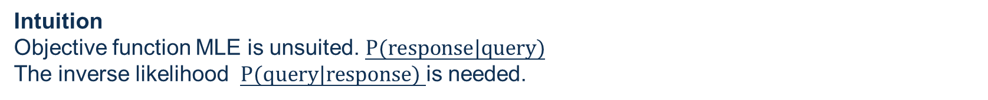
3.1 Model Modification
Paper 1: A Diversity-Promoting Objective Function for Neural Conversation Models (NAACL2016)
Problem : response generation task
Seq2seq tend to generate safe and generic response and most work used beam search.
Intuition
Objective function MLE is unsuited. $P(response|query)$
The inverse likelihood $P(query|response)$ is needed.
Method
Present MMI-antiLM and MMI-bidi model to produce a single non-trivial output.
Use Maximum mutual information (MMI) as an objective function.

Slide 10

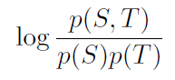


3.1 Model Modification
Paper 1: A Diversity-Promoting Objective Function for Neural Conversation Models
(NAACL2016)(cont)
Previous objective function →
Revised objective function → maximize mutual information
v
MMI-antiLM model
v
MMI-bidi model
We trained maximum likelihood models and used MMI criterion only during testing.
Notes:
lambda controls how much to penalize generic responses:

Slide 11


3.1 Model Modification
Paper 1: A Diversity-Promoting Objective Function for Neural Conversation Models
(NAACL2016)(cont)
MMI-antiLM model
MMI-bidi model
Lead to ungrammatical output
So replace p(T) with U(T)
Direct decoding is intractable
Generate N best list by P(T|S) and
Re-rank using the second term
v
v
Notes:
语法不对的例子，前面生成的词对后面decode的影响比较重要。建模成一个递减的

Slide 12
3.1 Model Modification
Paper 2: Building E2E dialogue Systems Using Generative Hierarchical Neutral Network model (AAAI2016)
Multi-turn
Problem : Dialogue generation task
Seq2seq tend to generate safe and generic response.
Past work only consider the diversity at word level when decoding.
Method
Define dialogue problem as modeling the utterances and interactive structure of the dialogue.
Present HRED model to hierarchically learn both word-level and query level feature.

Slide 13
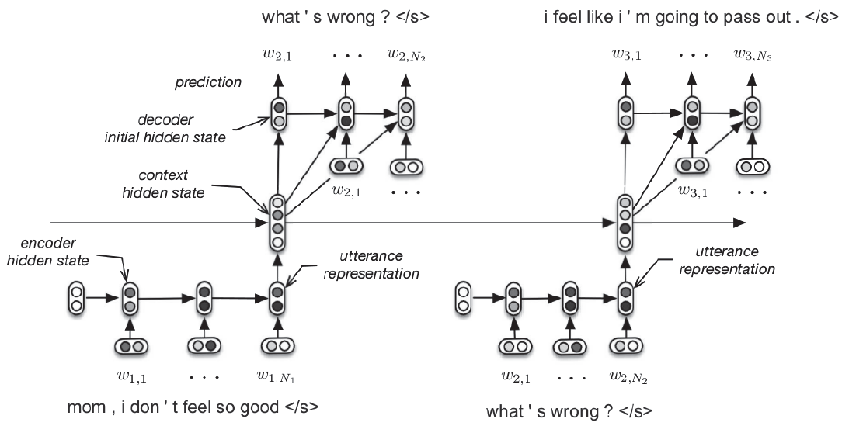


3.1 Model Modification
Paper 2: Building E2E dialogue Systems Using Generative Hierarchical Neutral Network model (AAAI2016) (cont)
Encoder
Higher level context Decoder
Decoder
Decoding is conditioned on the hidden state of the context RNN.
Notes:
produce a single nontrivial output.

Slide 14
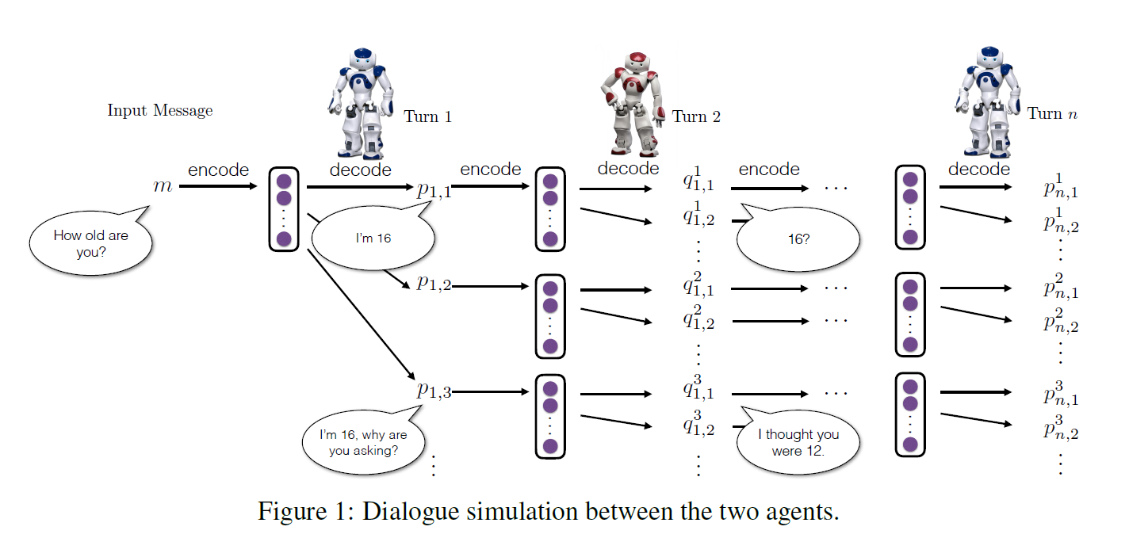
3.1 Model Modification
Paper 3: Deep Reinforcement Learning for Dialogue Generation
Multi-turn
Problem
Seq2seq tend to generate safe and generic response.
Stuck in an infinite loop of repetitive response
Intuition
Response generation tend to be short sighted and ignore future outcome.
Model future direction of a dialogue via RL
Three useful conversational properties:1) informativity 2) coherence 3) ease of answering
Method
Use encoder-decoder architecture as backbone
Simulate conversation between two agents and maximize expected reward rather than MLE
Notes:
produce a single nontrivial output.

Slide 15
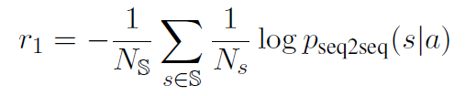




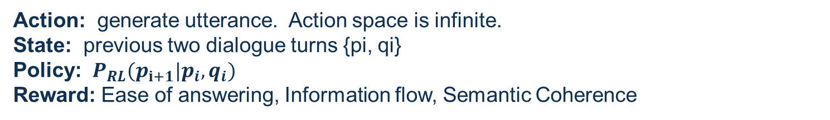
3.1 Model Modification
Paper 3: Deep Reinforcement Learning for Dialogue Generation (cont)
Use policy gradient
Action: generate utterance. Action space is infinite.
State: previous two dialogue turns {pi, qi}
Policy: ${ P}_{RL}(p_{i+1}|p_{i},q_{i})$
Reward: Ease of answering, Information flow, Semantic Coherence
Construct a dull response list $N_{s}$
Consider mutual info
Notes:
produce a single nontrivial output.

Slide 16


3.1 Model Modification
Paper 3: Deep Reinforcement Learning for Dialogue Generation (cont)
Simulation
Object function
Supervised Learning
Mutual Information
Dialogue simulation between two agent
A message from the training set is fed to first agent
4. Increase simulated turns
Evaluation
Long term success of dialogue is our goal (Do not use BLEU or perplexity.)
1) length of dialogue 2) diversity (distinct unigrams and bigrams) 3) human evaluation
The way to design reward and perform simulation
Notes:
produce a single nontrivial output.

Slide 17
3.2 Extra Feature Injection
Paper 4: Topic aware Neural Response Generation (AAAI2017)
Problem
Seq2seq tend to generate safe and generic response and quickly lead the conversation to an end.
Intuition
Generate informative and interesting response by utilizing topics information as prior knowledge
Method
Propose Topic-Aware response generation model.
Argument with joint attention and a biased generation probability
Notes:
produce a single nontrivial output.

Slide 18





3.2 Extra Feature Injection
Paper 4: Topic aware Neural Response Generation (AAAI2017)(cont)
How to obtain extra topic information?
Twitter LDA and estimate the parameters with Gibbs sampling algorithm
Pick out top N words under topic Z
Use distributions as vector representations of the topic words
Seq2seq model
Encoder = GRU, Decoder = standard RNN
2. Context Attention

Slide 19
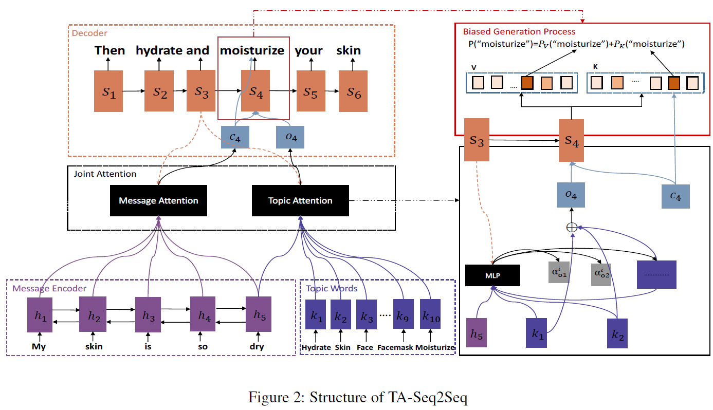
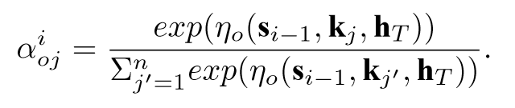
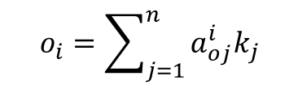
3.2 Extra Feature Injection
Paper 4: Topic aware Neural Response Generation (AAAI2017)(cont)
Joint attention
Weaken the effect of irrelevant words
Highlight the importance of relevant words
$$o_{i}=\sum_{j=1}^{n}{a_{oj}^{i}k_{j}}$$
Notes:
produce a single nontrivial output.

Slide 20
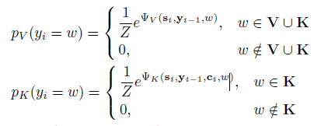



3.2 Extra Feature Injection
Paper 4: Topic aware Neural Response Generation (AAAI2017)(cont)
Extra probability term
$P\left(y_{i}\right)=Pv(y_{i}$)+${Pk(y}_{i})$
The way to combine topic feature
Notes:
produce a single nontrivial output.

Slide 21
3.2 Extra Feature Injection
Paper 5: Sequence to backward and forward sequence-An content introducing approach (AAAI2017)
Problem :
Seq2seq tend to generate safe and universally relevant sentences with little meaning.
Intuition
Use keyword that can reflect the main gist of the reply
Generate reply containing the given keyword
Method
Propose seq2BF model.
Predict a Noun as a keyword
Modify encoder-decoder model to synthesize a sentence containing the keyword

Slide 22
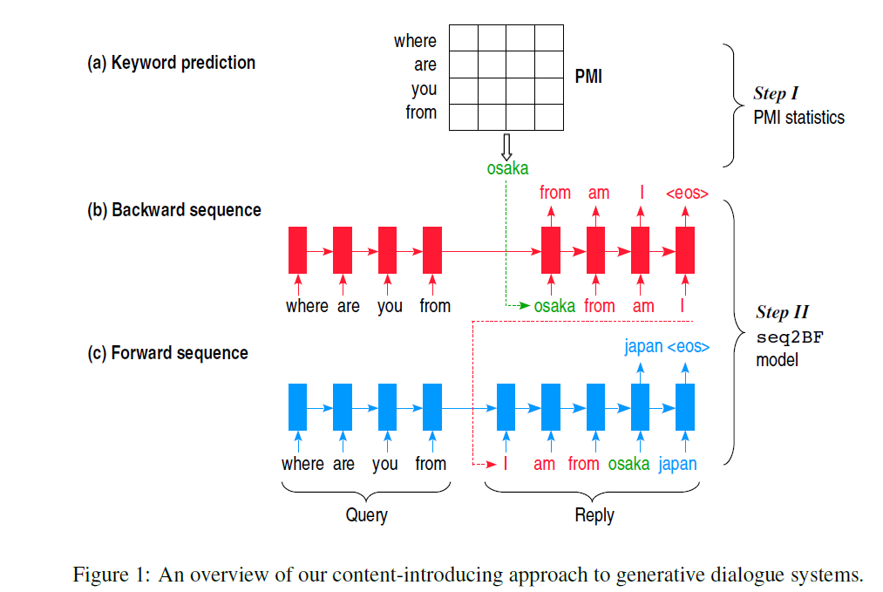

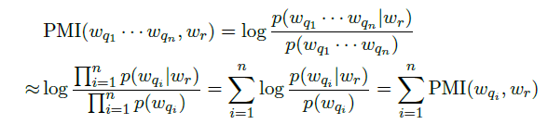
3.2 Extra Feature Injection
Paper 5: Sequence to backward and forward sequence-An content introducing approach (AAAI2017)(cont)
How to find the keyword ? → PMI
Notes:
produce a single nontrivial output.

Slide 23


3.2 Extra Feature Injection
Paper 5: Sequence to backward and forward sequence-An content introducing approach (AAAI2017)(cont)
seq2BF model
Generate backward half of the sequence and then the forward half
Encoder/decoder do not share parameters

Slide 24
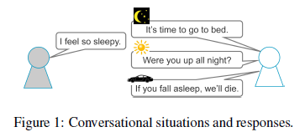
3.2 Extra Feature Injection
Paper 6: Modeling Situations in Neural Chat Bots (ACL2017)
Problem :
Main challenge of seq2seq model is the high degrees of freedom of responses.
Intuition
People converse with others while (implicitly) consider various conversational situations such as time, place, and the current context of conversation and even our relationship with the addressee
Method
Propose two models :local-global seq2seq and seq2seq with situation embedding
Task
Answer selection

Slide 25
3.2 Extra Feature Injection
Paper 6: Modeling Situations in Neural Chat Bots (ACL2017) (cont)
Situation = utterance + speaker profiles + time(season)
1. using K-means clustering to identify utterance and speaker to 10 classes.
2. split conversation data into 4 season types
Find the closest centroid obtained by k-means

Slide 26
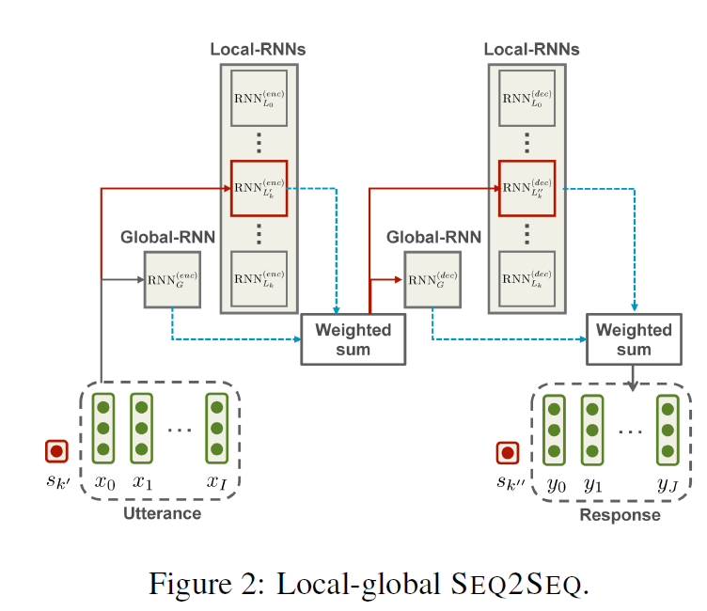
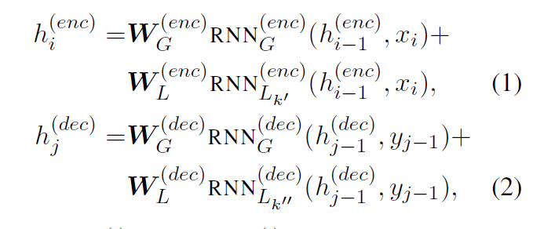
3.2 Extra Feature Injection
Paper 6: Modeling Situations in Neural Chat Bots (ACL2017) (cont)
Local-global seq2seq
local-RNN model individual situations at both speaker and addressee sides.
Local-RNN is updated when under the corresponding situation.
Global-RNN take all the data.
Embedding and softmax layers are shared.
Notes:
类别多的时候，每类数量少，导致学习比较稀疏

Slide 27
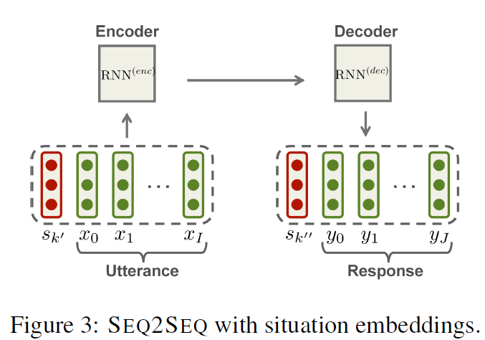
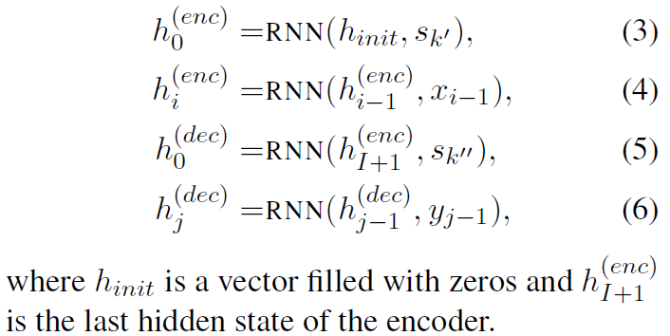
3.2 Extra Feature Injection
Paper 6: Modeling Situations in Neural Chat Bots (ACL2017) (cont)
Seq2seq with situation embedding
(Weakly situation-aware)

Slide 28
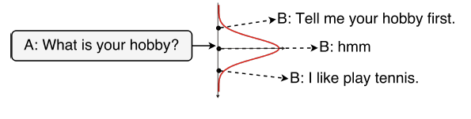
3.3 Latent Variable Representation
Why do we use latent variable ?
Traditional : Each word is sampled conditioned only on previous words → only source of variation is modelled through conditional output distribution.
Short and long term objectives need to be considered for conversation.
Short term objective → generate next token (word level ← LM easy to Learn)
Long term objective → sustain an output trajectory (discourse level)
one-to-many problem
Challenge
How to train VAE ?
Vanish of latent variable → LM dominate
KL annealing, word drop decoding, add extra loss
Notes:
观测数据是由潜变量Z生成的假设，通过去优化一个变分下界来训练一个分布趋近去潜变量的后验分布
gradually increasing the weight of the KL term from 0 to 1 during training
setting a certain percentage of the target words to 0

Slide 29
3.3 Latent Variable Representation
Paper 7: Learning discourse level diversity for dialog models using CVAE
(ACL2017)
Problem : response generation task
Encoder-decoder generate dull and generic response
Past work focus on diversifying the output of the decoder at word-level.
Intuition
Response generation in conversation is a ONE-TO-MANY mapping problem at the discourse level
A similar dialog context can have many different yet valid responses.
Learn a probabilistic distribution over the valid responses instead of only keep the most likely one.
Method
Present CVAE / kgCVAE adapted dialog model
Improve the training method of optimizing CVAE/VAE for text generation
Notes:
.

Slide 30
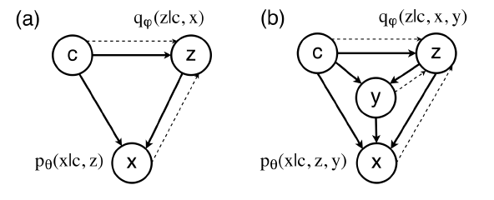
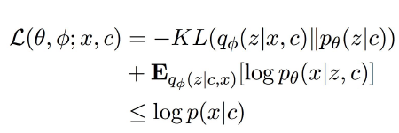
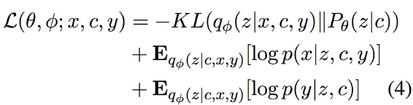
3.3 Latent Variable Representation
Paper 7: Learning discourse level diversity for dialog models using CVAE
(ACL2017)(cont)
Graphical model
C: context
Z: latent variable
X: the desired response
Y: expert knowledge (dialog act in this paper)
Objective function
CVAE
kgCVAE
Notes:
.

Slide 31

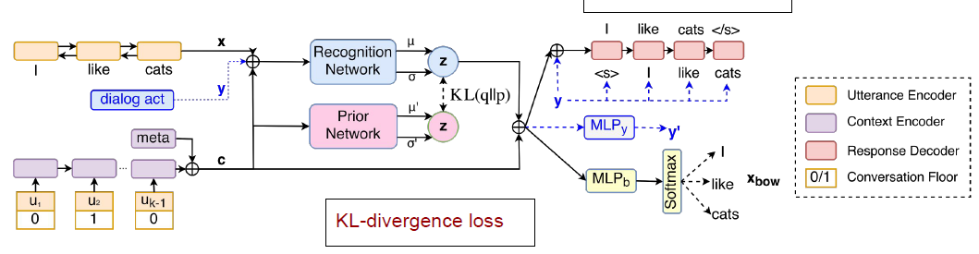
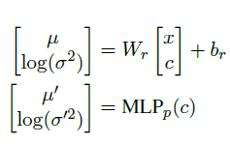
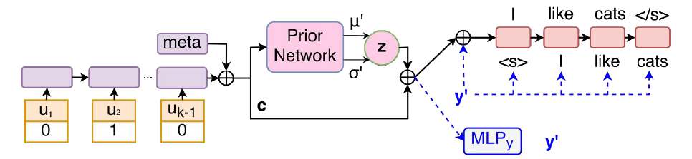
3.3 Latent Variable Representation
Paper 7: Learning discourse level diversity for dialog models using CVAE
(ACL2017)(cont)
Training
Recognition & Prior network
Testing
Encoder = BiGRU
Decoder = 1-layer GRU
Notes:
.

Slide 32
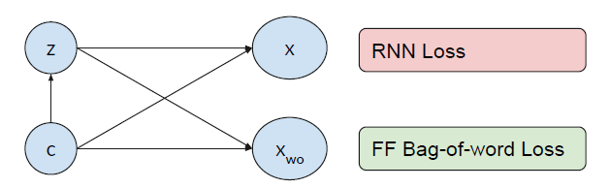

3.3 Latent Variable Representation
Paper 7: Learning discourse level diversity for dialog models using CVAE
(ACL2017)(cont)
Vanishing latent variable problem
RNN decoder can cheat by using LM information and ignore Z !
BOW loss
1. predict the BOW in the responses X at once
2. break the dependency between words and eliminate the chance of cheating based on LM
Notes:
.

Slide 33
3.3 Latent Variable Representation
Paper 8: A conditional Variational framework for dialog generation (ACL2017)
Problem
Deep latent variable models have been shown to facilitate the response generation.
However, latent variables are highly randomized, leading to uncontrollable responses.
Method
This paper proposes a framework allowing conditional response generation based on specific attributes.
Dialog state for both speakers are modeled separately in order to reflect personal features.
Notes:
.

Slide 34
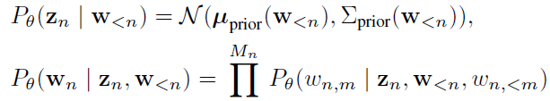
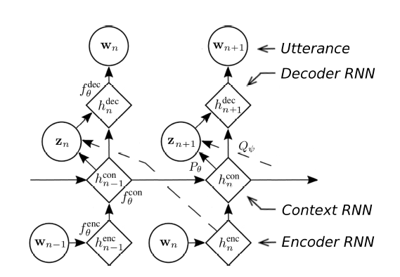

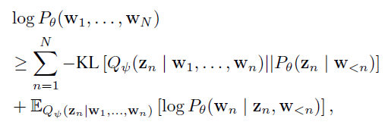
3.3 Latent Variable Representation
Paper 8: A conditional Variational framework for dialog generation (ACL2017) (cont)
Motivated by VHRED (Serban et al., 2017)
1. latent variable can only be explained as higher level decisions like topic.
2. lack the ability of explicitly controlling the generating process
MLP
Multiplication
Objective function
Notes:
.

Slide 35

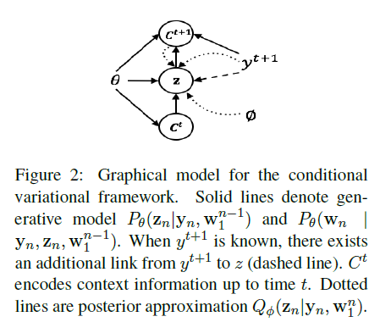
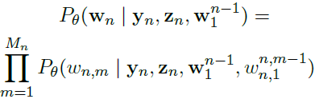
3.3 Latent Variable Representation
Paper 8: A conditional Variational framework for dialog generation (ACL2017) (cont)
Two scenarios are considered:
y is generic response or not
y represents positive, negative or neutral sentiment
Notes:
.

Slide 36
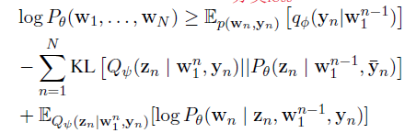
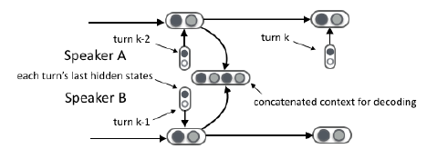
3.3 Latent Variable Representation
Paper 8: A conditional Variational framework for dialog generation (ACL2017) (cont)
SPHRED:
an encoder RNN for tokens and two status RNNs for utterance.
When modeling turn k, each status RNN takes as input the last encoder RNN state of turn k-2.
The higher level context vector is the concatenation of both status vectors.
Classification loss
Notes:
.

Slide 37
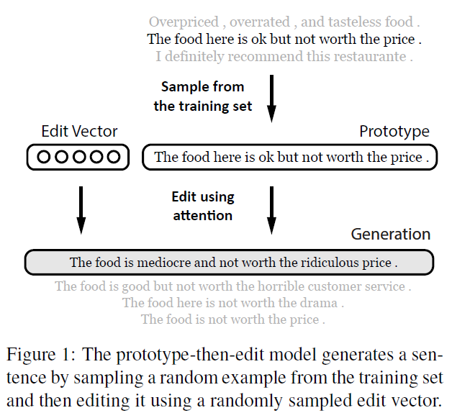
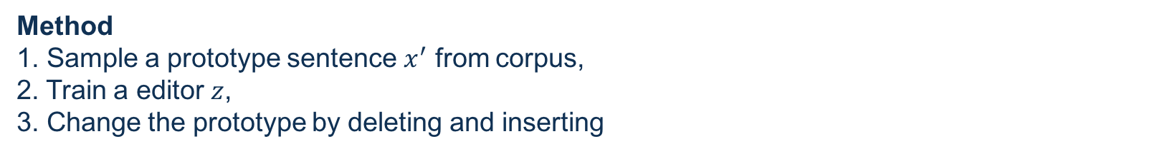
3.4 Prototype-then-edit model *
Paper 9: Generating sentences by editing prototypes
Problem :
recurrent neural LM generates sentences from scratch, often in left-to-right manner, which suffer from the problem of favoring generic utterances.
Naïve strategies to increase diversity have been shown to compromise grammaticality
Intuition
It’s difficult even for humans to write complex text from scratch in a single pass, but often create an initial draft and incrementally revise it.
Method
1. Sample a prototype sentence $x^{′}$ from corpus,
2. Train a editor $z$,
3. Change the prototype by deleting and inserting
Notes:
.

Slide 38


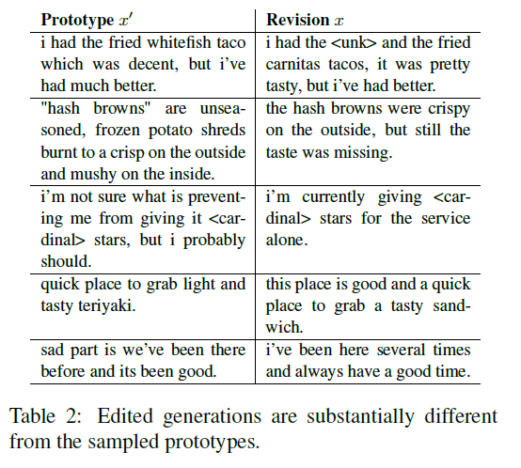
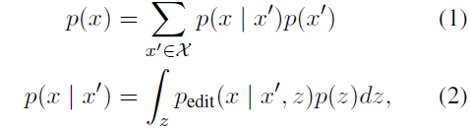
3.4 Prototype-then-edit model *
Paper 9: Generating sentences by editing prototypes (cont)
Primary goal : Primary goal: learn a generative model of sentence
Secondary goal: train a neural editor to capture semantic properties
Semantic smoothness:
An edit can alter the semantics by a small and well-controlled amount.
2. Consistent edit behavior
How to maximize ??
Notes:
.

Slide 39

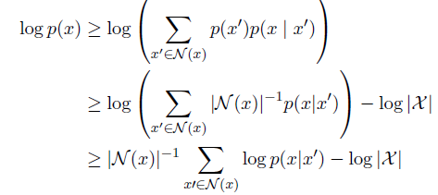
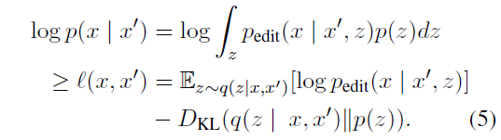

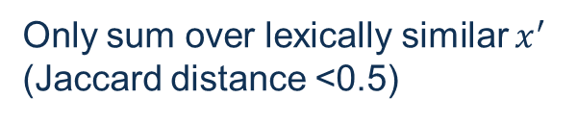
3.4 Prototype-then-edit model *
Paper 9: Generating sentences by editing prototypes (cont)
Prototype selection
Neural editor modeling Z
Only sum over lexically similar $x^{′}$
(Jaccard distance <0.5)
Lower bound the integral over edit vectors by
Modeling z with VAE
Notes:
.

Slide 40



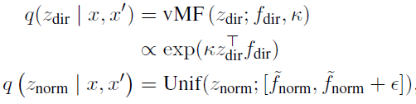

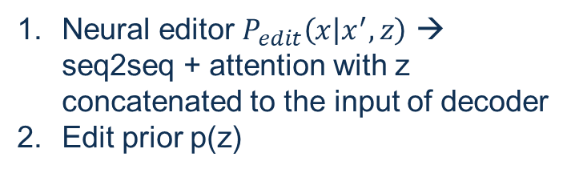
3.4 Prototype-then-edit model *
Paper 9: Generating sentences by editing prototypes (cont)
Neural editor modeling
Neural editor $P_{edit}\left(x | x^{′},z\right)$ → seq2seq + attention with z concatenated to the input of decoder
Edit prior p(z)
von-Mises Fisher distribution
3. Editor posterior $q(z|x,x^{′})$
Objective function

Slide 41
Conclusion
Most dialogue models are based on encoder-decoder model.
Extra information and well-designed context representation are important to ensure coherence and diversity.
Reinforcement Learning open up a new path to sustain multi-turn dialogue.
Evaluation for response generation is still a question.
Notes:
.

Slide 42
Thank You

